Slide 1
NE 591: Advanced Reactor Materials
Fall 2021
Dr. Benjamin Beeler

Slide 2
Last Time
Wrapped up TRISO particle-based reactors
Walked through a number of different fuel failure mechanisms
Current state of TRISO fuel performance modeling
Advanced concepts in TRISO

Slide 3
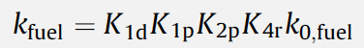
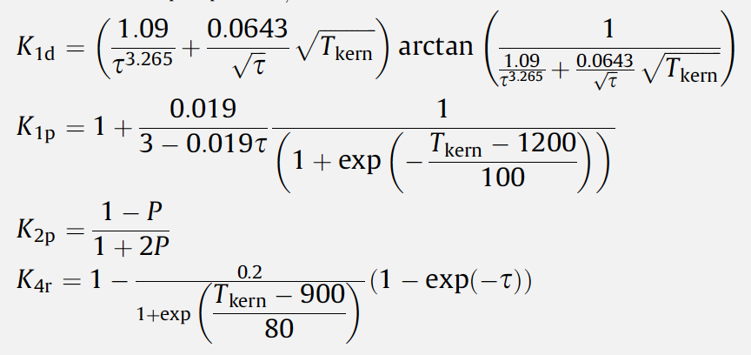
Questions
tau is burnup
k1d – fission products in solid solution
k1p – fission product precipitates
k2p – porosity
k4r – irradiation damage

Slide 4
Sodium Cooled fast reactors

Slide 5
Sodium Cooled Fast Reactors (SFRs)
Two main families:
Liquid metal cooled reactor, which utilizes MOX fuel
Integral fast reactor, which utilizes metallic fuel
SFRs are designed for management of high-level wastes and management of plutonium and other actinides
Important safety features of the system include a long thermal response time, a large margin to coolant boiling, a primary system that operates near atmospheric pressure, etc.

Slide 6
SFRs
Pool vs Loop
In the pool type, the primary coolant is entirely contained in the main reactor vessel, which therefore includes not only the reactor core but also a heat exchanger (US EBR-2, French Phenix)
In the loop type, the heat exchangers are external to the reactor tank (French Rapsodie, BN-350)

Slide 7
SFRs
Currently operating SFRs:
BN-600 (Russia), BN-800 (Russia), CEFR (China), FBTR (India), Joyo (Japan)
Benefits of liquid metal coolants:
metals atoms are weak neutron moderators, allowing for fast neutron spectrum
sodium melts at 371K and boils at 1156K, a total temperature range of 785K between solid and gas states, whereas water is only 100K at atmospheric pressure
boiling temperature is well above operational temperatures
sodium is non-corrosive, compatible with metallic fuel
sodium has higher thermal conductivity than water
Drawbacks:
sodium catches on fire in air, reacting with water to form hydrogen gas
requires special precautions to prevent and suppress fires and limit sodium leaks

Slide 8
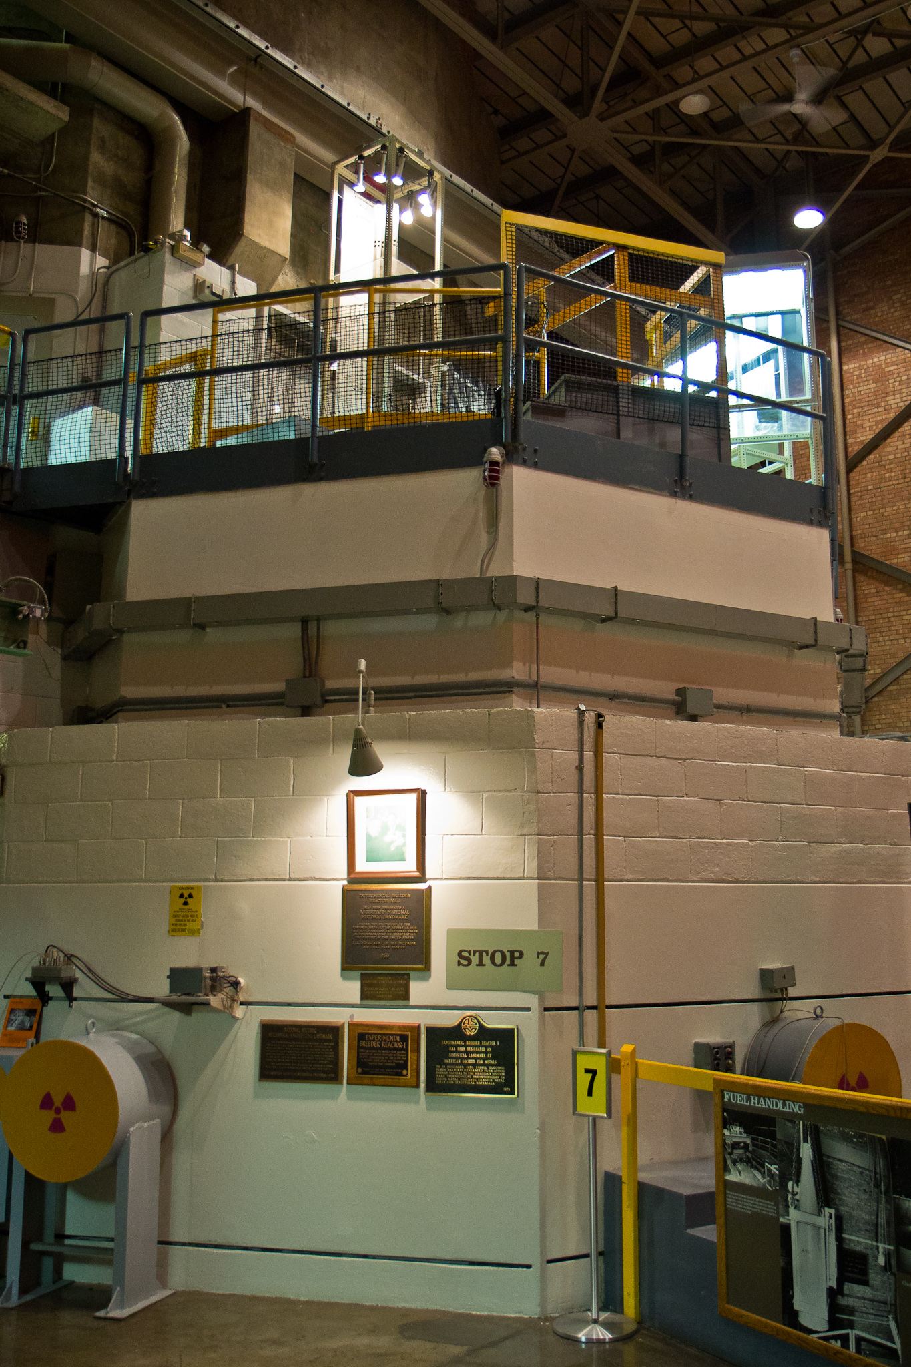
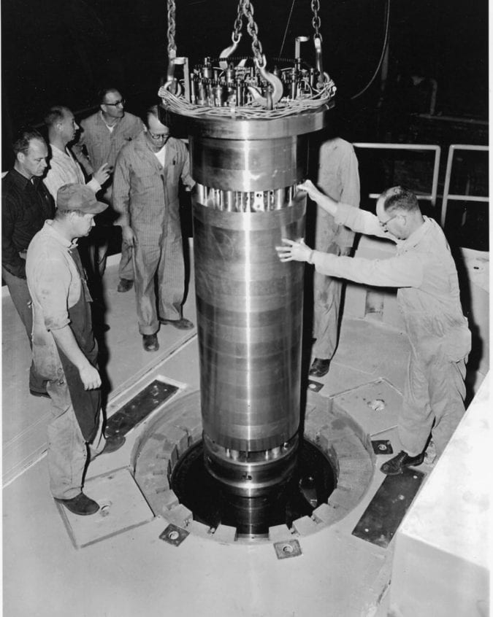
History of SFRs
Sodium-cooled fast reactors were among the first to be designed, built, and operated
EBR-I
ANL-W, INL
Startup in Dec. 1950
The world’s first breeder reactor
Demonstrated the ability to breed fuel
Utilized metallic fuel and NaK coolant

Slide 9
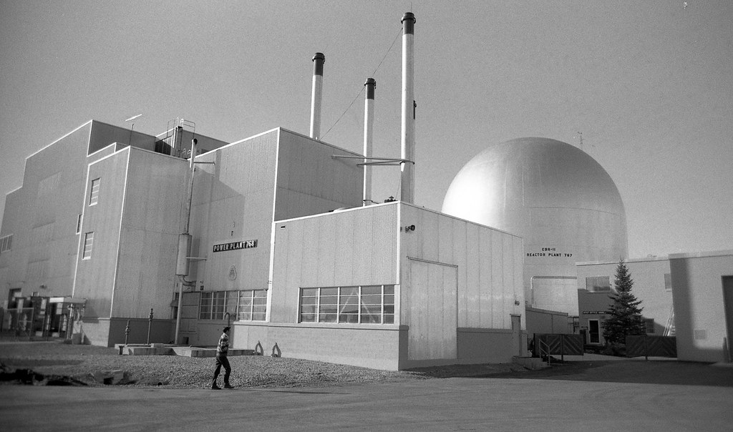
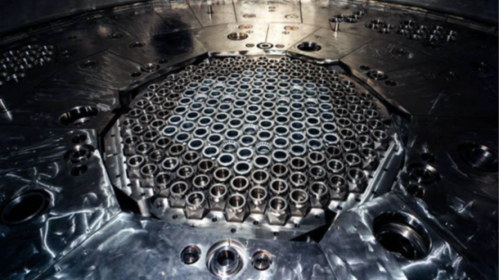
Key SFRs in the US
EBR-II (1965-1994)
Purpose was to demonstrate a complete breeder-reactor power plant with on-site reprocessing of solid metallic fuel
It demonstrated its ability to self-cool its fuel through natural convection of the sodium coolant during the decay heat period following the shutdown
FFTF (1980-1992)
Operated as a national research facility to test various aspects of commercial reactor design and operation, especially relating to breeder reactors
Large portions of current knowledge on metal fuel and fast flux environment derive from these reactors

Slide 10
Increased Safety
Metal fuel has excellent transient capabilities
The metal fuel itself does not impose any restrictions on transient operations or load-following capabilities
The robustness of metal fuel is illustrated by the following sample history of a typical driver fuel irradiated during the EBR-II inherent passive safety tests conducted in 1986:
40 start-ups and shutdowns
5 15% overpower transients
3 60% overpower transients
45 loss-of-flow (LOF) and loss-of-heat-sink tests including a LOF test from 100% power without scram

Slide 11
Increased Safety
Metal fuel also has benign run beyond cladding breach (RBCB) performance characteristics
After 150+ days of operation with a cladding breach, metallic fuel retained shaped and did not exacerbate the breach
oxide
metal
oxide

Slide 12
Inherent Safety
Although the metal fuel melting temperature is much lower than that of oxide fuel, it is also much more difficult to raise the fuel temperature because of the 10X higher thermal conductivity
Thus, operating margins in terms of power can, in fact, be greater for the metal core than for oxide
The high thermal conductivity and the thermal inertia of the large sodium pool can shut the reactor down during very severe accident situations, without depending on human intervention
One experiment in EBR II (LOFWS) simulated station blackout, combined with loss of emergency power supply, failure of primary and secondary shutdown systems, and no operator action – a worst case
The rising coolant temperature during accident causes thermal expansion of the core components which enhances the neutron leakages and hence slowing down the chain reaction
Due to this negative reactivity feedback, the reactor power is shut down all by itself and the coolant temperature rise stops

Slide 13
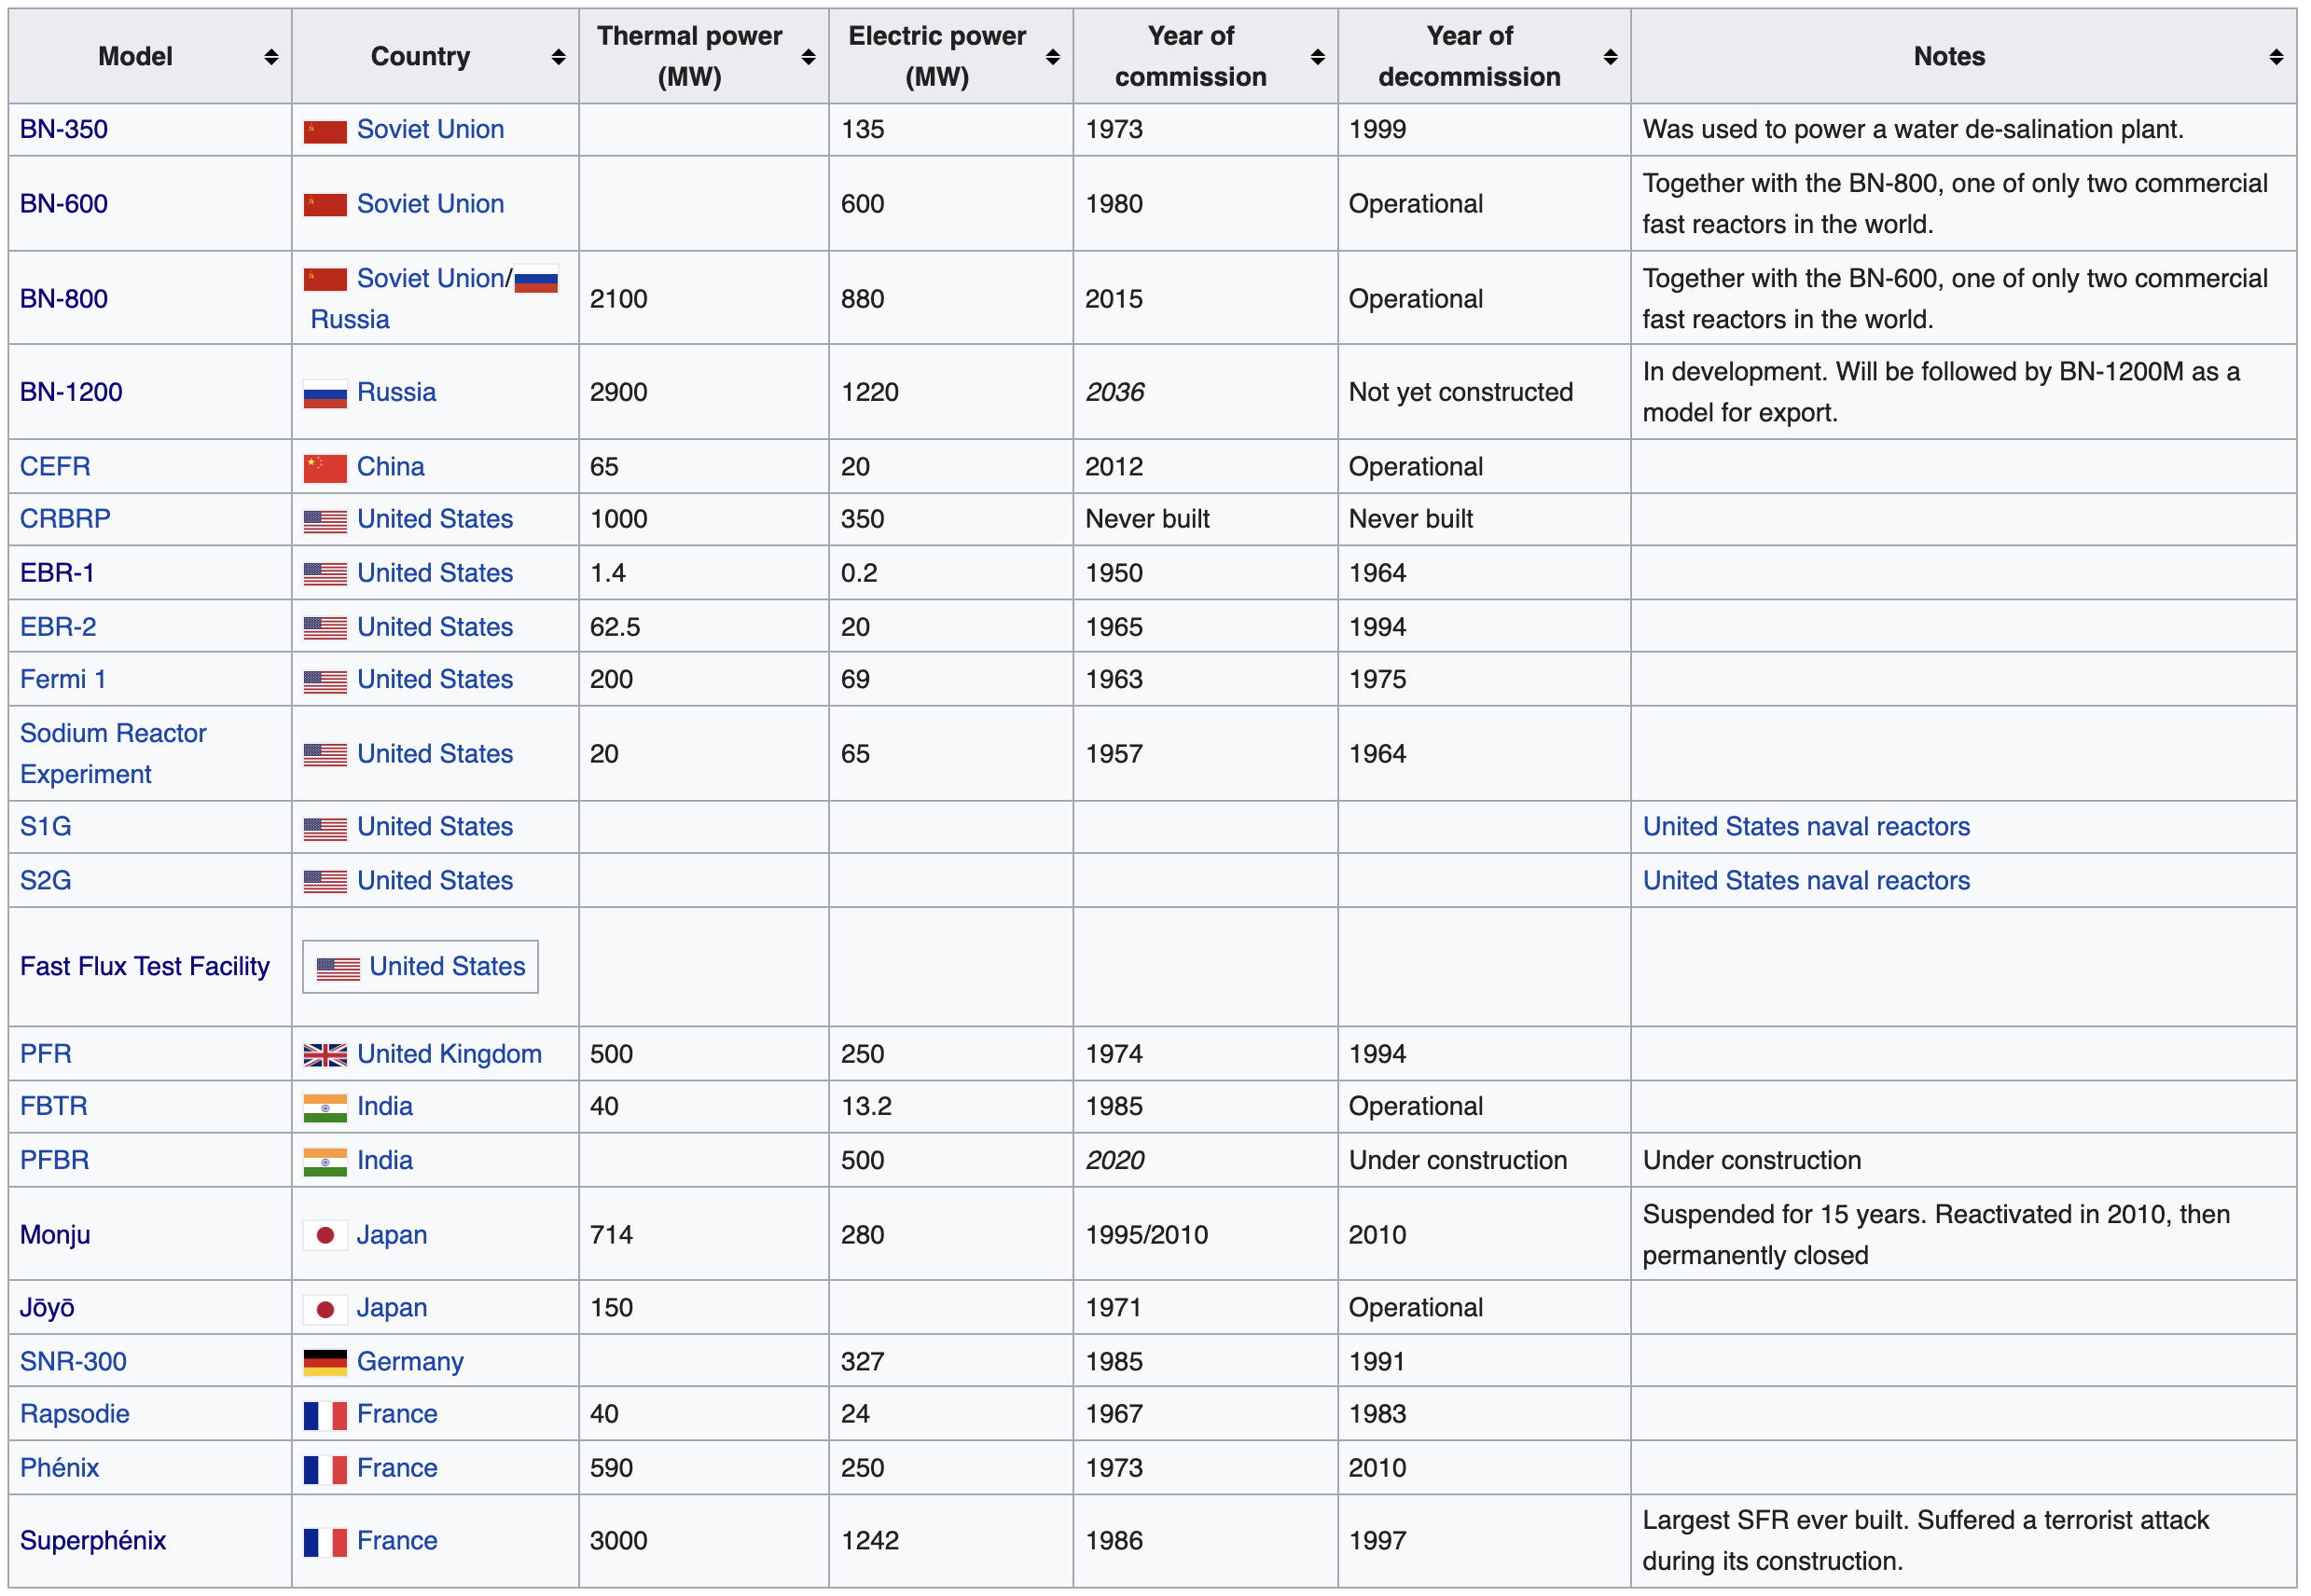
Summary of SFR Usage

Slide 14
Metal fuel

Slide 15
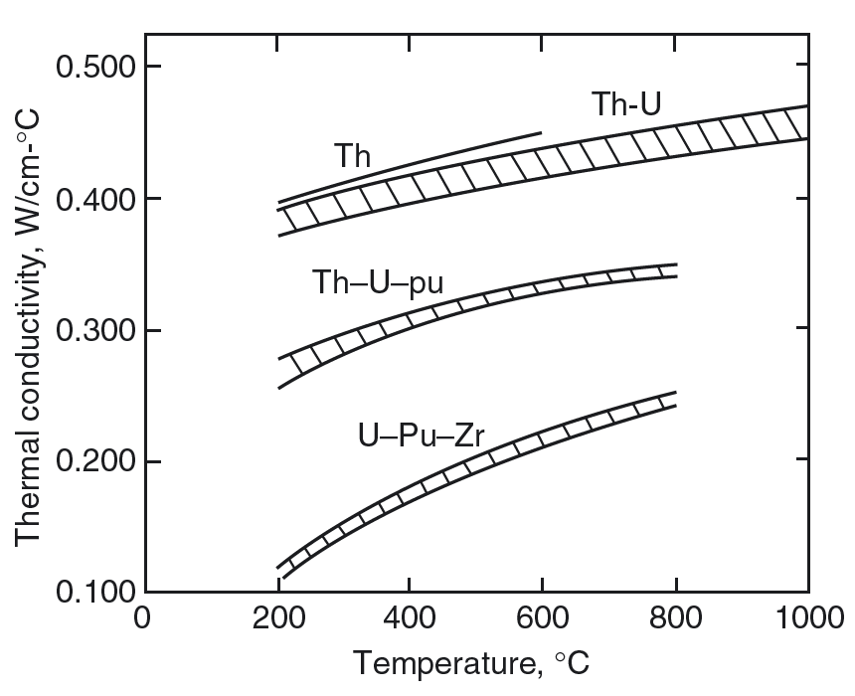
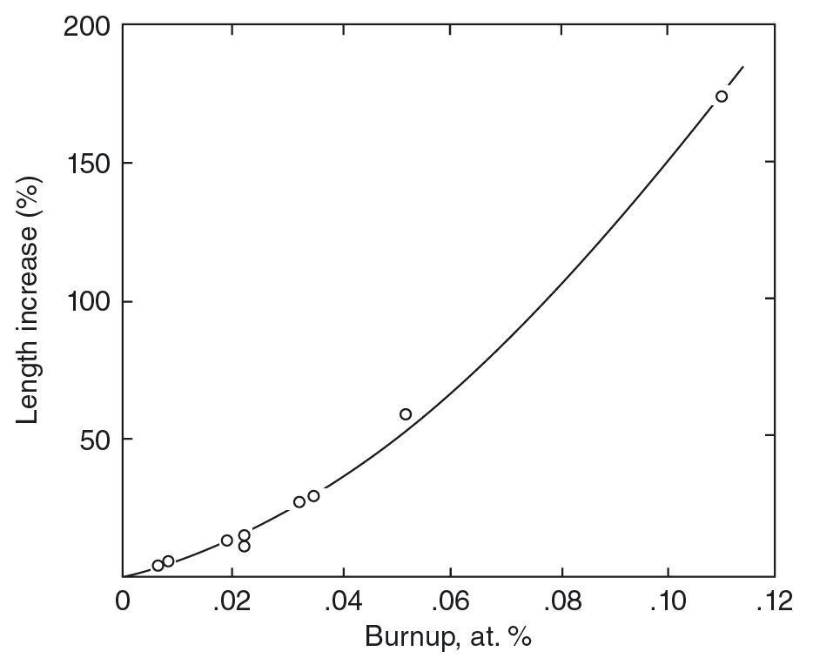
First Metal Fuels
Starting in the late 1940s, metallic fuels dominated the early development of nuclear reactors because of their key attributes of high fissile-atom density and good thermal conductivity
Alloys of U, Pu were of interest, and alloys with Th were pursued to increase thermal conductivity
Initial experiments with pure U metal met with spectacular swelling and growth, as observed in the mid 1950s

Slide 16
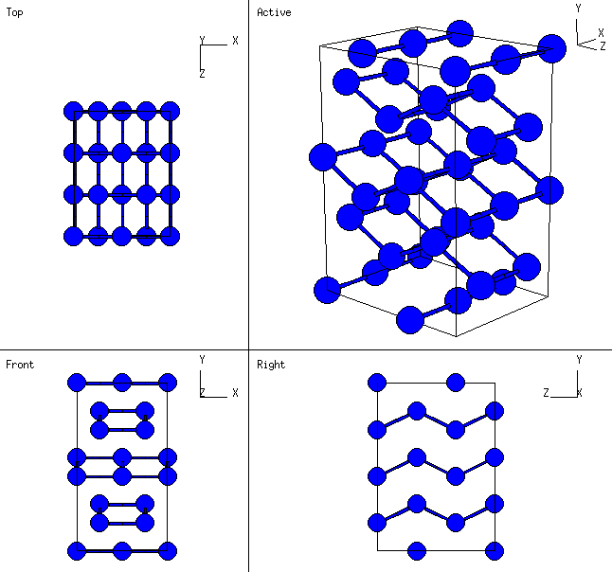
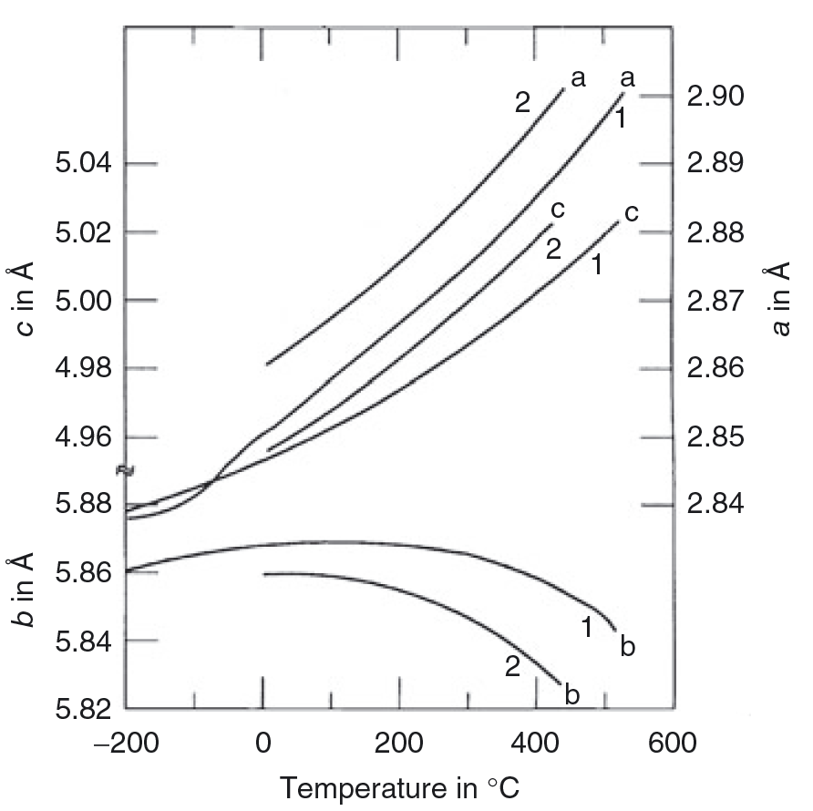
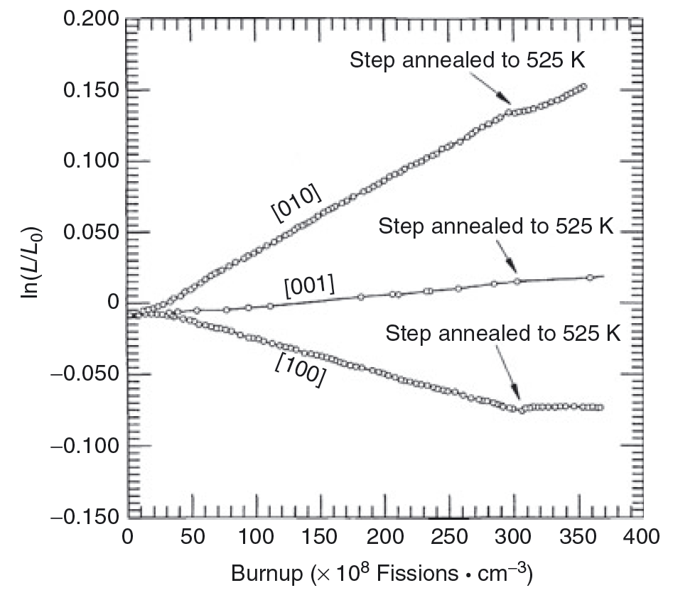
Alpha U
The most important irradiation characteristic of α-U is its dimensional instability in the form of anisotropic growth and swelling, which results from the anisotropy of the orthorhombic crystal structure
In addition to anisotropic thermal expansion, irradiation growth occurs anisotropically
The current theory of this phenomenon is that fission-generated interstitials and vacancies form loops on {010} and {110} planes, respectively, as a result of the anisotropic thermal expansion induced in α-U by thermal spikes in displacement cascades

Slide 17
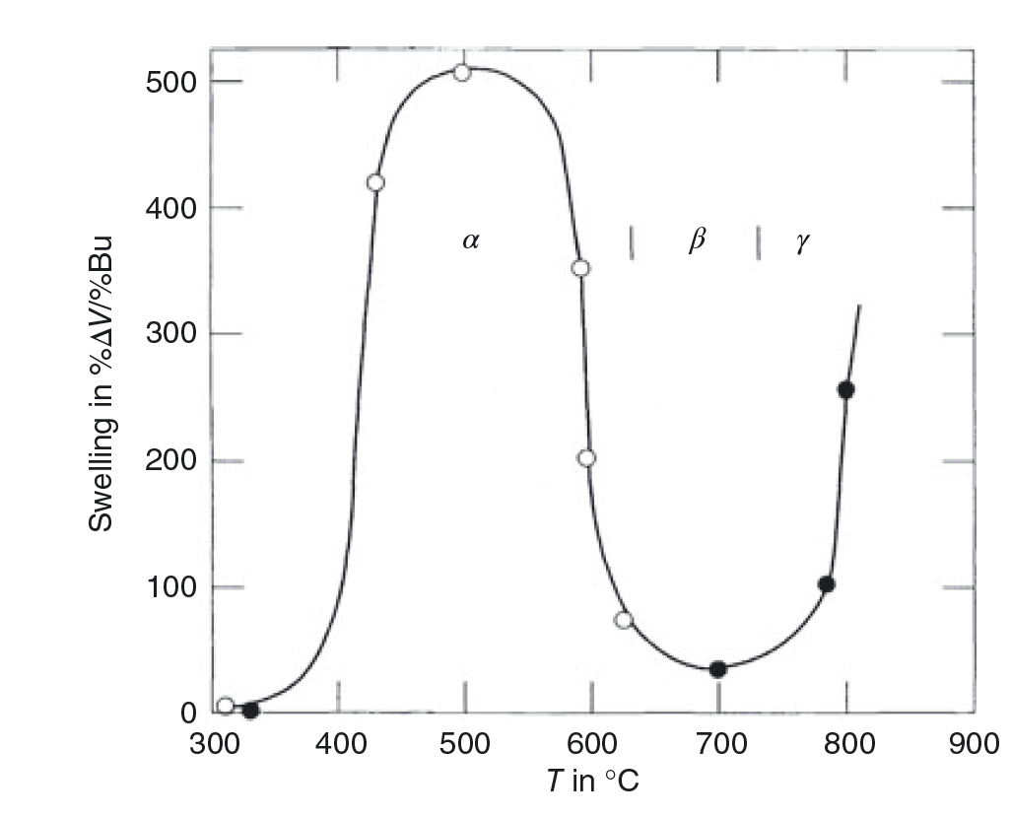
Alpha U Swelling
The temperature dependence of the irradiation growth process takes on a bell-shaped form, due to recombination of point defects
In a polycrystalline sample, irradiation growth in individual grains results in shape changes and mismatched strains between the individual grains
The stress developed due to these mismatched strains can be released by plastic deformation at the grain boundaries; this is commonly referred to as tearing or cavitation
Cavitation swelling dominates between 400 and 600 C

Slide 18
Alpha U Swelling
Lower temperature regime cavitation swelling results in a swirled microstructure, with irregular cavities formed by tearing of grain boundaries
At higher temperatures (500-600 C), the cavities along the grain boundaries can be crystallographically aligned, and are potentially related to twinning
Cavitation can be reduced by minor additions of alloying elements, which can serve to affect the defect evolution in the system

Slide 19
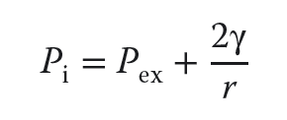
Swelling in Gamma U
Swelling in the higher temperature phases occurs primarily by growth of fission gas bubbles, and is isotropic
All phases will also have solid fission product swelling
Fission gas is effectively insoluble in metallic U, and thus prefers to precipitate
Sufficiently large bubbles can maintain an equilibrium gas pressure by balancing the surface tension and the external pressure
This growth is described by the Young-Laplace equation
The external pressure is determined by the plastic flow characteristics of the fuel surrounding the bubble and the mechanical restraint of the cladding
Fission gas swelling can be substantial, and must be accounted for

Slide 20
Alloying to modify properties
As with alpha U, small alloying additions were explored to limit the fission gas swelling behavior
Adjusted U – U alloyed with small amounts of Al, Fe, or Si
Additions form precipitates and act as point defect sinks, limiting swelling for low burnups
U-Fissium contained Mo-Ru, with lesser amounts of Rh, Pd, Zr, and Nb, and was the early EBR II fuel
Higher content alloys have focused on elements that form extensive solid solutions with U in the high-temperature γ-phase, specifically Mo, Zr, Ti, and Nb
These elements lower the temperature of the cubic γ-phase boundary, allowing more of the fuel to operate in the isotropic γ-phase; they also increase the solidus temperature, raising the margins at which the fuel melts
The addition of Zr and Mo seem to most substantially reduce the swelling of metallic U and low T and low burnup

Slide 21
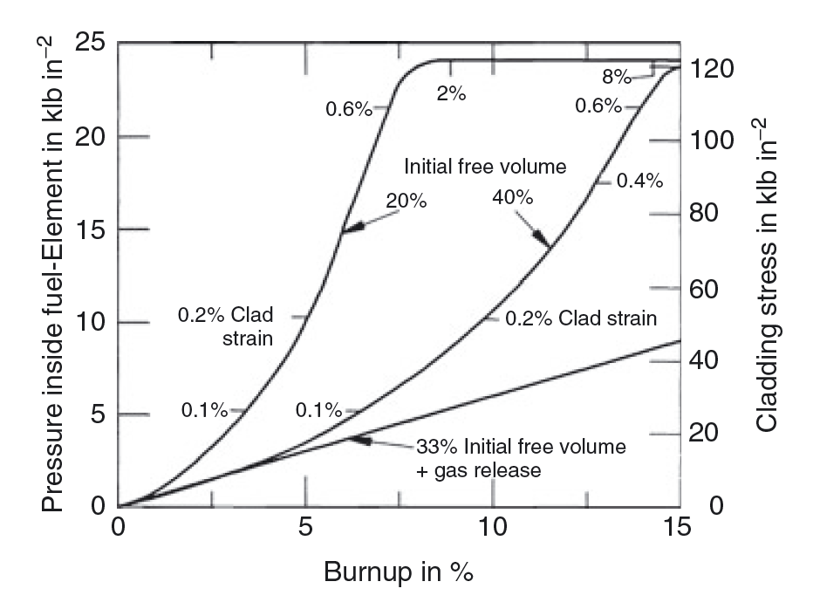
Accommodation of Swelling
With high-content alloys, calculations of fuel swelling and gas release showed that if 30-40% free volume was afforded inside the cladding, fuel could swell, and when it contacted the cladding, allowing for mechanical strength of cladding to counteract further radial swelling
It was found that the majority of fission gas is released by about 30% swelling, and by including a large plenum, stresses on cladding could be reduced

Slide 22
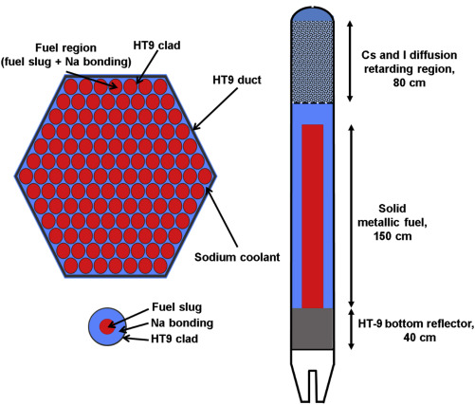
Metal Fuel
Metal fuels are ideal for fast reactors because they have higher densities of fissile and fertile materials and provide higher breeding ratio
The burnup of metal fuel in the early days was limited to a few atom percent (at.%) because of the increase in the fuel–cladding mechanical interaction (FCMI) caused by gas swelling of fuel alloys
Reducing the fuel smear density to about 75% is effective in promoting fission gas release before fuel-cladding contact and in suppressing FCMI

Slide 23
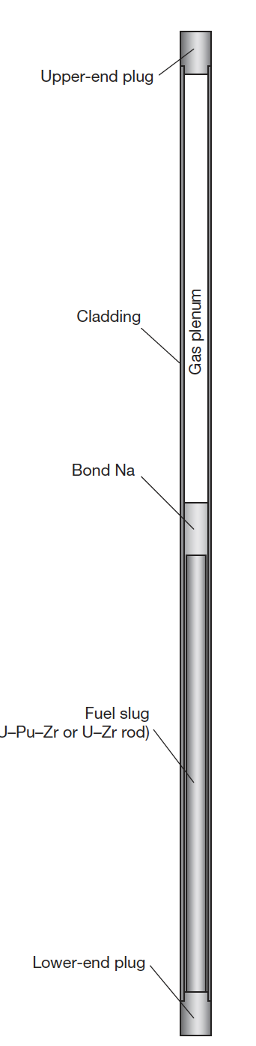
Base Metal Fuel System
The typical metallic fuel consists of a U(Pu)–10 wt% Zr fuel slug with ~75% smear density
The cylindrical fuel alloy rod is called a ‘fuel slug
The annular gap between the fuel slug and the cladding is filled with sodium (bond sodium)
A relatively large gas plenum (1-1.5x fuel length), which is a space above the fuel slug, is provided to mitigate the pressure of the fission gas accumulating during irradiation

Slide 24
Closing the Fuel Cycle
An important factor in selecting a fuel form for fast reactors is ease of fuel recycling, including reprocessing and fuel refabrication
Pyrometallurgical processing, called ‘melt refining,’ can be combined with refining techniques to recycle spent metallic fuel
This recycling process has been demonstrated for uranium alloy fuels in the 1960s, where fuel alloys were recycled as many as four times, and the fuel was returned to the reactor within 4–6 weeks of its removal from the reactor core
Will talk more about this later

Slide 25
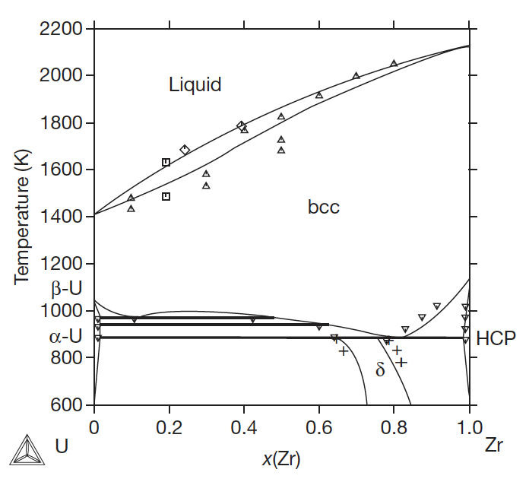

The U-Zr System
Metallic uranium is alloyed with Zr to stabilize the bcc phase, increase the melting point, improve mechanical properties, and reduce swelling
Typical composition is 10 wt.%, or approximately 23 atom %
At relevant temperature ranges in SFRs, multiple phases will be present

Slide 26
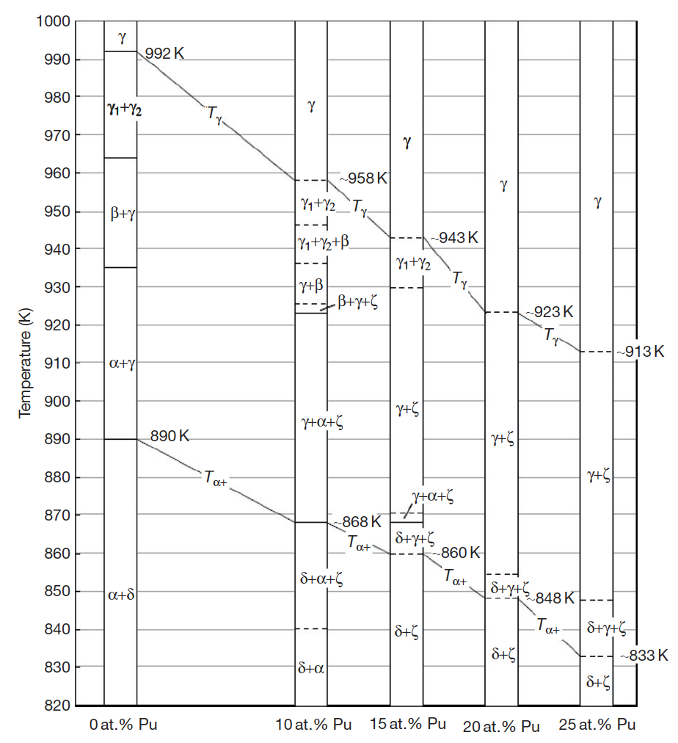
U-Pu-Zr
Ternary phase diagram isotherms
γ: Body-centered cubic (bcc), has complete solid solubility for bcc ε-plutonium and bcc β-zirconium
α: Orthorhombic allotropic modification of uranium that dissolves up to 15 at.% of plutonium, but has limited solubility for zirconium
β: Tetragonal allotropic modification of uranium that dissolves up to 20 at.% of plutonium, but has limited solubility for zirconium
η: A high-temperature intermediate phase in the U–Pu binary system that is believed to be tetragonal and has limited solubility for zirconium
ζ: A complex cubic U–Pu intermediate phase that dissolves up to 5 at.% zirconium
δ: A hexagonal intermediate phase in the U–Zr system that occurs approximately at the composition UZr2 and has extensive solid solubility for plutonium

Slide 27
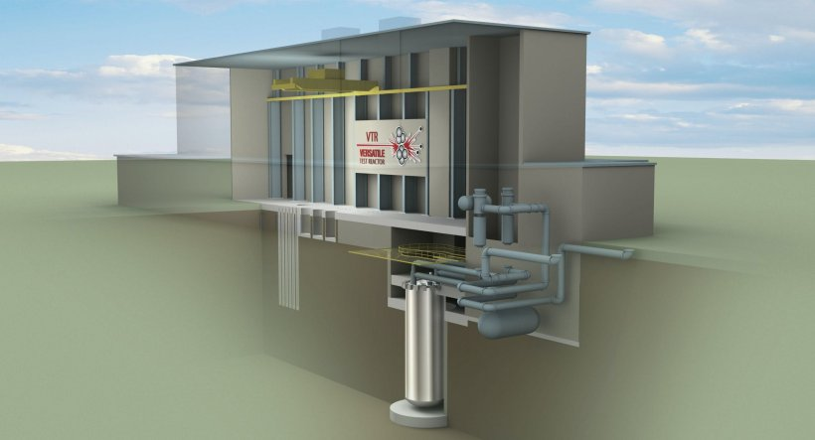
U-Pu-Zr
The U-Pu-Zr system was the fuel choice for the Integral Fast Reactor design of the 1980s, and the current Versatile Test Reactor design
U-Pu-Zr alloys are the most recent alloys under active exploration, and thus have the most recent experimental data

Slide 28
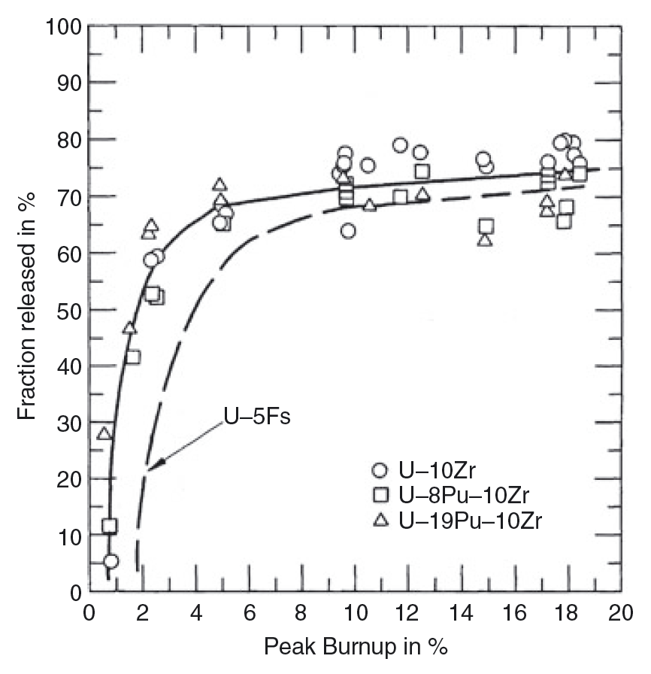
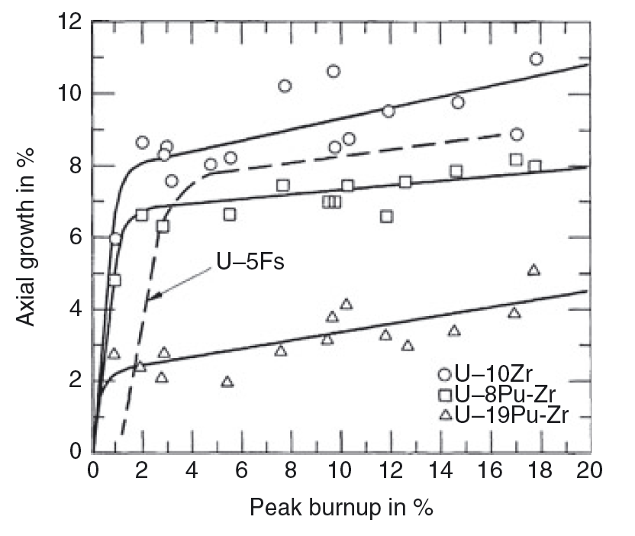
U-Pu-Zr Swelling
Swelling is typical of metallic fuels, in that it occurs rapidly, leveling off once in contact with the cladding
Fission gas release occurs within the first 5% burnup, corresponding with the rapid swelling
These fuels swell less in the axial direction than in the radial direction, if isotropic swelling is assumed

Slide 29
U-Pu-Zr Swelling
The is believed to be due to the difference in swelling behavior between the hotter center of the fuel pin and the colder periphery
The gamma phase dominates in the center of the fuel pin at high temperatures
This phase has large gas bubbles, indicative of a higher plasticity of the fuel and, therefore, a lower capability to sustain shear stresses
gamma

Slide 30
U-Pu-Zr Swelling
The alpha phase dominates on the colder periphery of the fuel pin, and has smaller, textured porosity
The alpha phase is known to have higher strength, and is assumed to be less plastic than gamma
The fission gas pressure in the center would can potentially result in a near-biaxial loading of the peripheral shell, the radial stress component being twice the axial component
A stress effect on swelling in the peripheral fuel zone would result in a larger radial strain, and hence anisotropic swelling
alpha

Slide 31
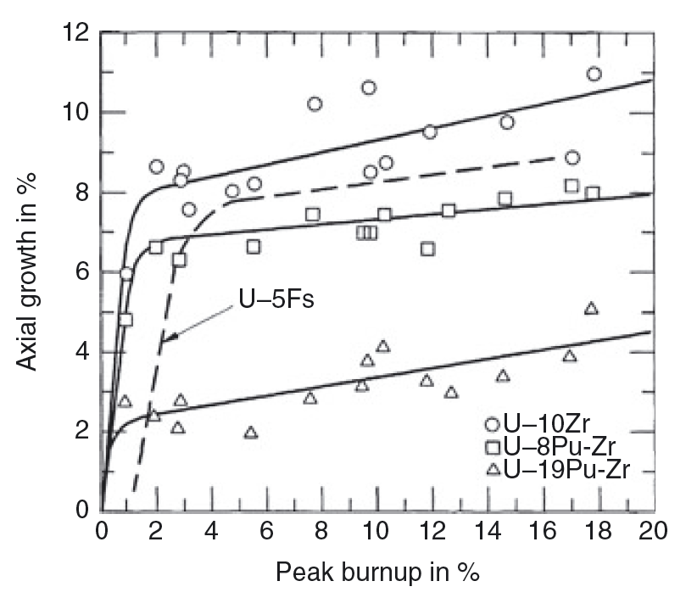
U-Pu-Zr
An increase in the Pu content exacerbates the anisotropic swelling
This is believed to be driven by the redistribution of Zr along the temperature gradient of the fuel

Slide 32
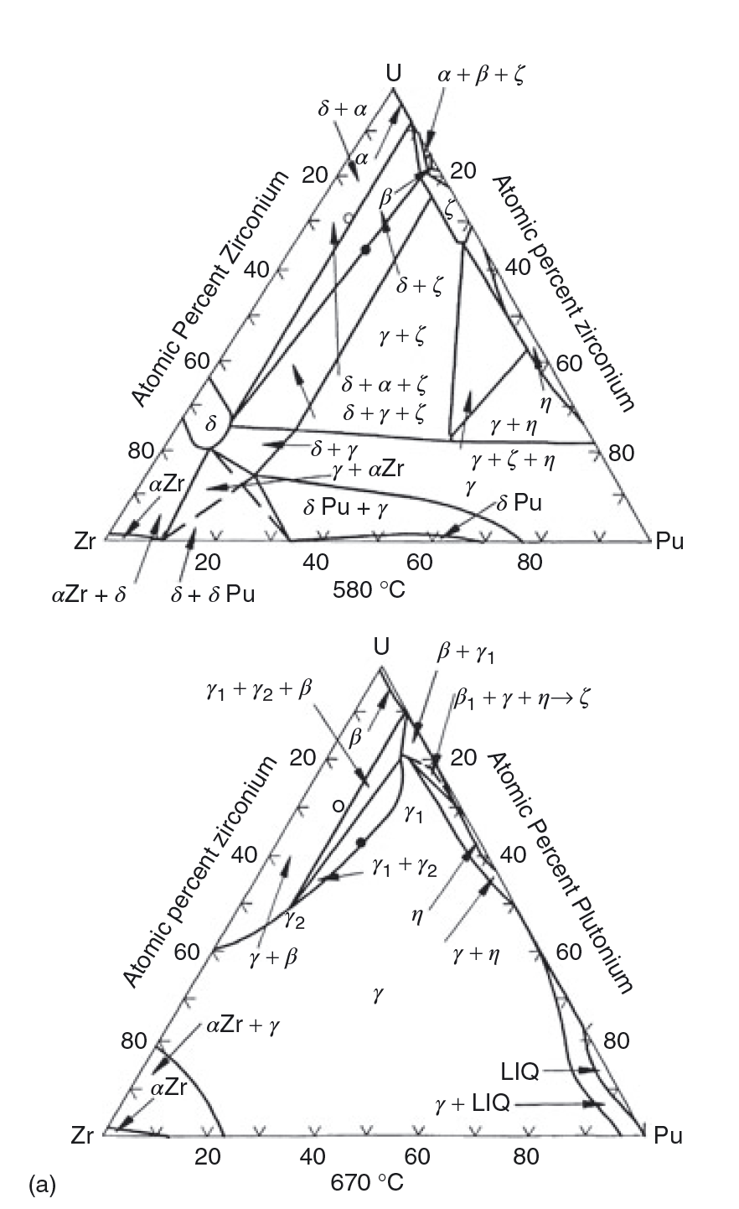
U-Pu-Zr
Various phase boundaries exist radially across the fuel
The solubility of Zr in these phases varies with temperature; thus, a driving force for diffusion can be created both by the gradient in chemical potential, and by the temperature gradient

Slide 33
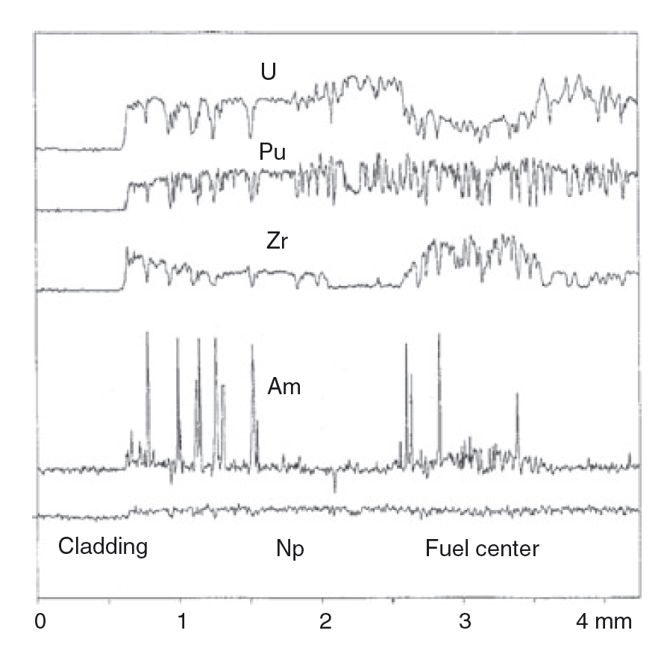
Redistribution
There can exist three compositional regions: 1) enriched Zr, 2) depleted Zr, 3) as-fabricated Zr
Zirconium diffuses up the temperature gradient to the high temperature gamma phase, leaving the intermediate temperature beta U phase
Uranium compensates by diffusing to the intermediate region
At lower T, Zr is enriched in the periphery in the delta phase

Slide 34
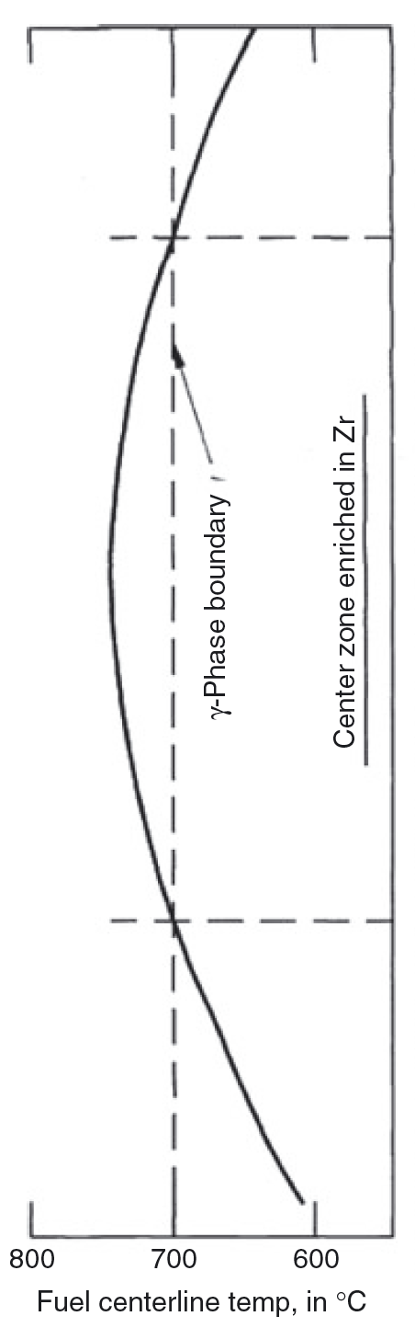
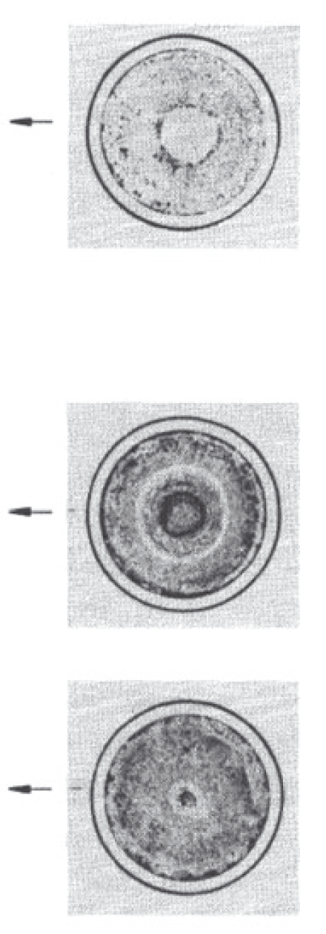
Redistribution
The location of the radial zones essentially follows isotherms in the fuel which are determined by the various phase boundaries of the alloy
The extent of redistribution, and the radial location of the individual compositional regions, varies axially with temperature
Both chemical potential and Soret effect diffusion contribute

Slide 35
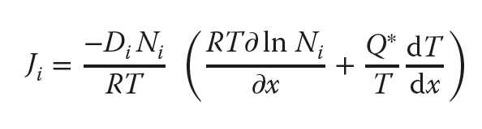
Soret Diffusion
Soret effect is a phenomenon observed in mixtures of mobile particles where the different particle types exhibit different responses to the force of a temperature gradient
The solute flux in a temperature gradient is characterized by the heat of transport, Q*, of the migrating solute according to Fick’s law:
where Di and Ni are the diffusivity and concentration of the migrating solute
The heat of transport can be either positive or negative, depending on the sign and magnitude of its components

Slide 36
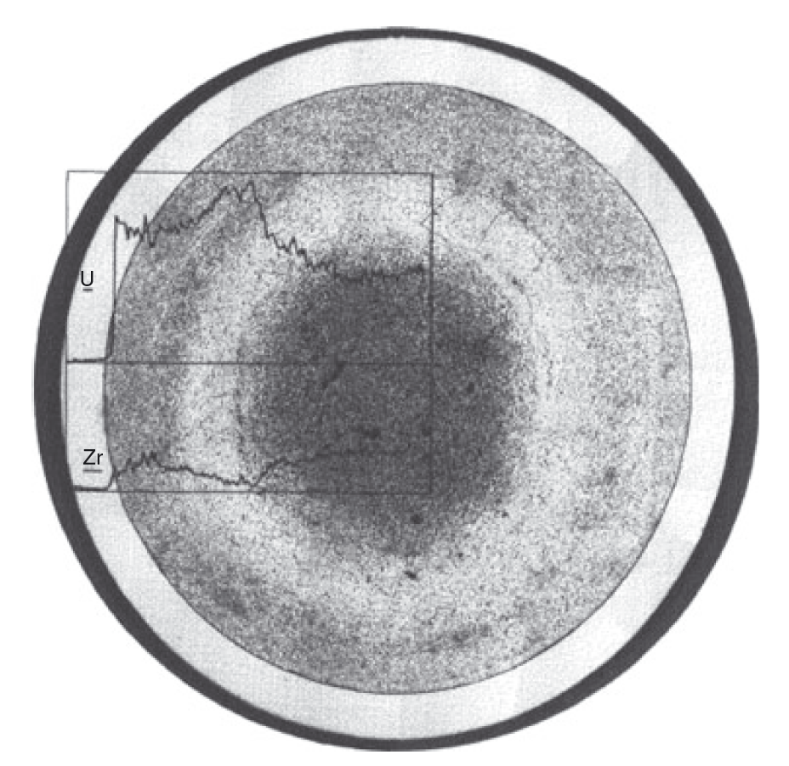
Soret Diffusion in UZr
The value of Q* for pure U was measured to be +5 kcal/mol and to be −34 kcal/mol for Zr
Thus, in their pure states, U moves down a temperature gradient while Zr moves up, but it is unknown if this behavior directly translated to U-Zr alloys
For low Pu content alloys, the rate of redistribution is similar to UZr

Slide 37
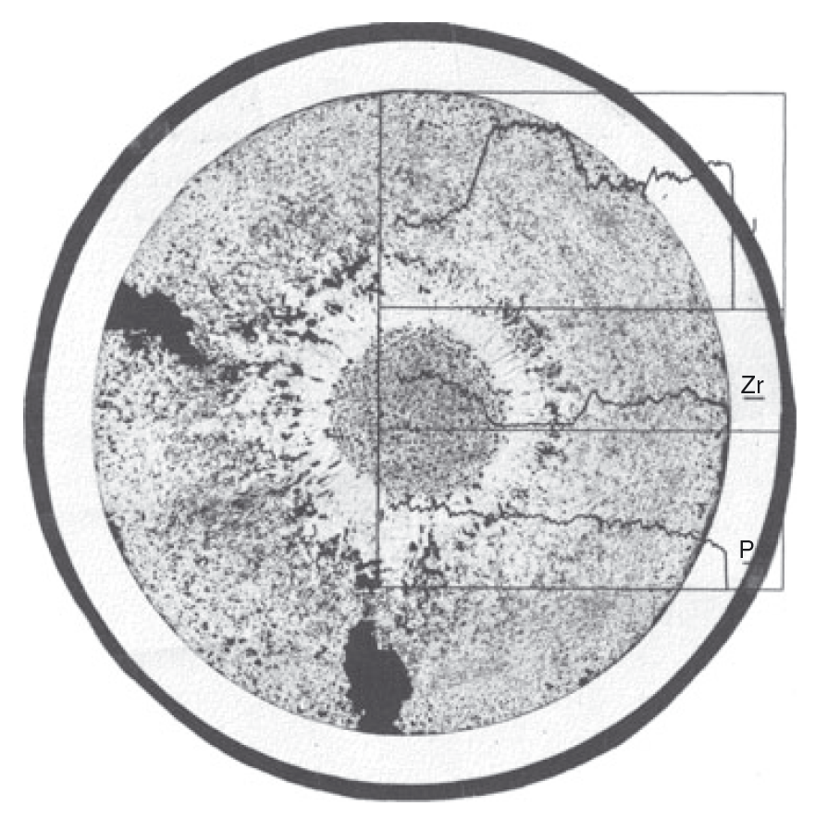
Soret Diffusion in UZr
For high Pu content alloys (>19%), redistribution is much more rapid
At the right is a 3% burnup fuel slug at a similar power density to the U-Zr slug in the previous slide
There is either a higher chemical driving force, or more rapid Zr diffusion present in these alloys
This more rapid redistribution can lead to greater anisotropic swelling, and thus more rapid radial swelling

Slide 38
Summary
SFRs and Metallic Fuel
Inherent safety associated with high thermal conductivity, large margin to boiling for Na, negative reactivity
Alpha U undergoes anisotropic expansion and irradiation growth
Alloy to stabilize gamma phase and improve properties
Swelling is inevitable, can accommodate with smear density
Include large plenum to accommodate fission gas release
Radial redistribution of chemical species driven by thermodynamics and Soret diffusion

